Slide 1
< CS3213 Assignment 1 >
Joseph Matthias Goh
A0087072A

Slide 2
< CS3213 Assignment 1 >
KWIC-KWAC-KWOC
Given a list of sentences and a list of words to ignore, we parse through the sentences, removing the words to ignore.

Slide 3
< CS3213 Assignment 1 >
Model
View
Controller

Slide 4
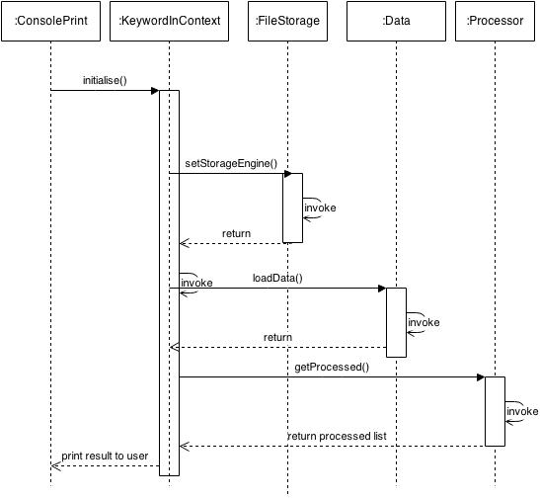
< CS3213 Assignment 1 >

Slide 5
< CS3213 Assignment 1 >
Model
View
Controller

Slide 6
< CS3213 Assignment 1 >
Data-centric
User-input
Output

Slide 7
< CS3213 Assignment 1 >
Extensible
Data
IStorage
std::in
File system
Database
Management
System

